Slide 1
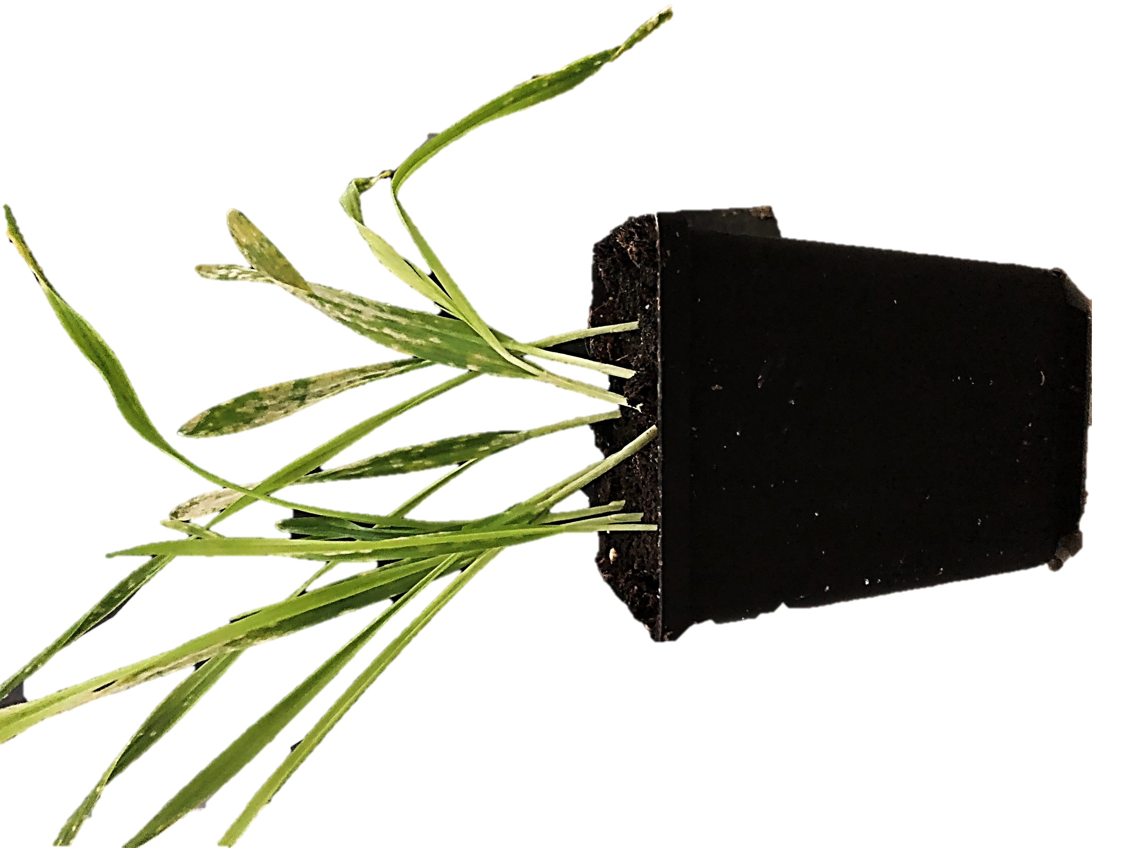
We study the infection of barley (Hordeum vulgare) with the powdery mildew fungus Blumeria graminis f. sp. hordei (Bgh).
Check our research page for more detail.

Slide 2

Plant-Microbe Interactions
We study the infection of barley (Hordeum vulgare) with the powdery mildew fungus Blumeria graminis f. sp. hordei (Bgh).
Check our research page for more detail.
2021
Group Picture
PhD Student
Bachelor/
Master
Student
Team Leader
Research
Assistant
PostDoc
You?
You?
Isabel
TBD
You?

